Slide 1
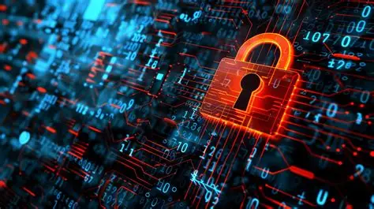
Cybersecurity Basics
name: Aman batool
Course: bs avm
Date:10-10-25

Slide 2
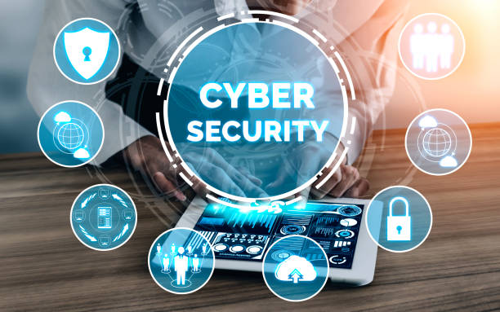
What Is Cybersecurity?
Cybersecurity = protecting computers, networks, and data
Prevents theft, hacking, and misuse
Important because daily life relies on technology (banking, communication, storage)

Slide 3
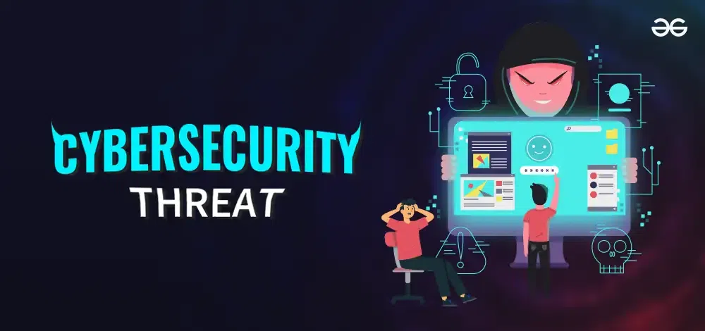
Common Cyber Threats
Malware – harmful software
Phishing – fake emails/messages
Ransomware – locks files for money
Social Engineering – tricking people
Password Attacks – guessing/cracking weak passwords

Slide 4
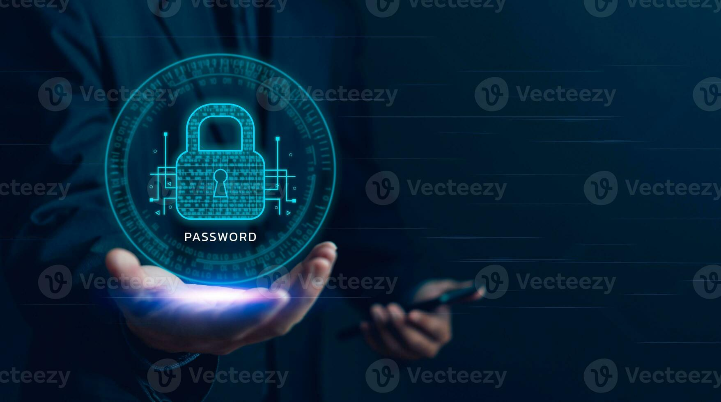
Password Safety
Use 12+ character strong passwords
Mix uppercase, lowercase, numbers, symbols
Turn on Two-Factor Authentication (2FA)
Don’t reuse passwords
Never share passwords with anyone

Slide 5
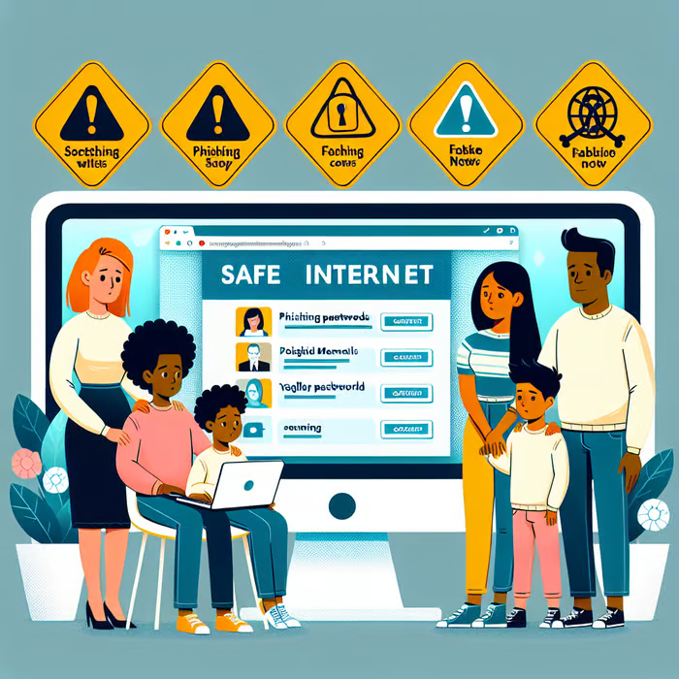
Safe Internet Practices
Avoid suspicious links and attachments
Verify website URLs
Keep apps and OS updated
Avoid public Wi-Fi for banking/logins
Download apps only from trusted stores

Slide 6
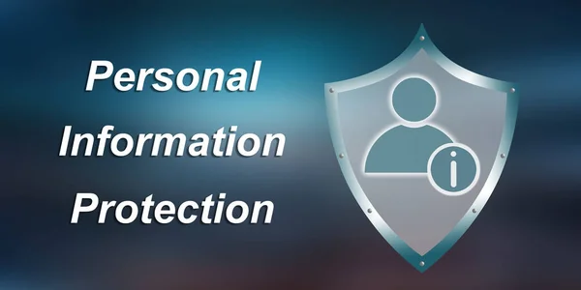
Protecting Personal Information
Limit sharing on social media
Don’t post private details (address, ID numbers)
Use privacy settings
Be aware that online posts are permanent
Think before you share

Slide 7
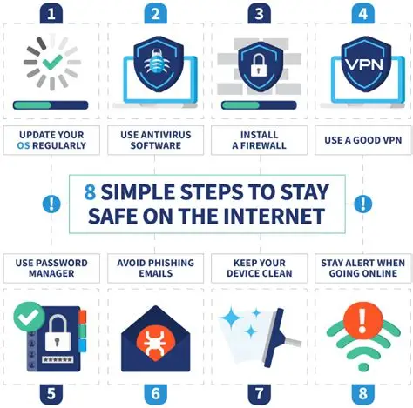
How to Stay Secure
Install and update antivirus
Backup important files regularly
Use firewalls and secure networks
Report suspicious activity
Stay informed about new security tips

Slide 8

Conclusion
Cybersecurity is everyone’s responsibility.
Small actions like strong passwords, safe browsing, and regular updates can prevent major risks.
Staying aware and cautious helps protect your data, your identity, and your devices.
“Stay alert, stay secure!”

